Slide 1



Software engineering (Undergraduate)
Chapter 4 project evaluation
Course Name software Development project management
CSC 4125
(Undergraduate)
M. Mahmudul hasan
Assistant Professor, CS, AIUB
http://www.dit.hua.gr/~m.hasan

Slide 2
program
Collection of projects
Contributes to same overall organizational goals
Effective program management requires well defined program goal
Project must be evaluated
How it contributes to the program goal
Viability (usefulness)
Timing
Resourcing
Final worth

Slide 3
Strategic & Technical assessment
Value of any project is increased by the fact that it is part of a program
For a successful strategic assessment there should be a strategic plan clearly defining the organization’s objectives
The Program Director and Program Executive will be responsible for the strategic assessment of a proposed project
Technical assessment of a proposed system consists of evaluating the required functionality against the hardware and software available

Slide 4
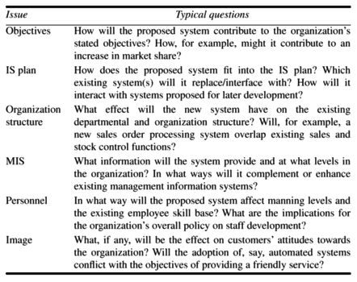
Strategic assessment issues & questions

Slide 5
Portfolio Management
Portfolio management is the centralized management of one or more portfolios, which includes identifying, prioritizing, authorizing, managing, and controlling projects, programs and other related work to achieve specific strategic business objectives.
When an organization is developing a software system, they could be asked to carry out a strategic and operational assessment on behalf of the customer.
The proposed project will form part of a portfolio of ongoing and planned projects and the selection of projects must take account of the possible effects on other projects in the portfolio and overall portfolio profile.

Slide 6
Project, program, Portfolio Management
A portfolio is defined as projects, programs, subsidiary portfolios, and operations managed in a coordinated manner to achieve strategic objectives.
A program is defined as related projects, subsidiary programs, and program activities managed in a coordinated manner to obtain benefits not available from managing them individually.
A project is a temporary endeavor undertaken to create a unique product, service, or result. A project may be managed in three separate scenarios:
Stand-alone (outside a portfolio or program)
Within a program
Within a portfolio
Note: Project management has interactions with portfolio and program management when a project is within a portfolio or program.

Slide 7
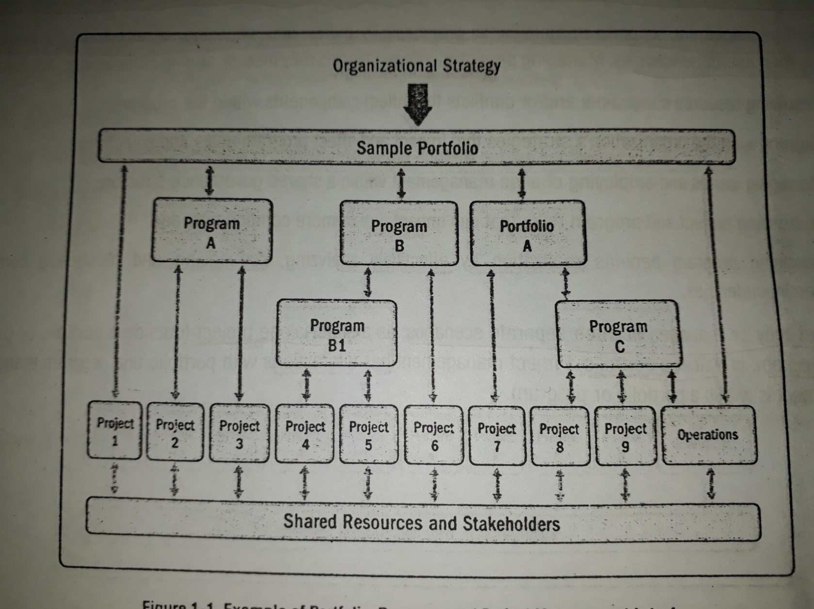
Project, program, Portfolio Management

Slide 8
Cost-benefit analysis
Any project requiring an investment must provide a greater benefit than putting that investment in a bank.
Assessment is based upon the question of whether the estimated costs are exceeded by the estimated income and other benefits.
It is necessary to ask if the project under consideration is the best of a number of options.
Projects will need to be prioritized so that any scarce resources may be allocated effectively.
COST-BENERIT Analysis Steps
Identifying and estimating all of the costs and benefits of carrying out the project
Expressing these costs and benefits in common units (e.g. BDT, EUR, USD)

Slide 9
Cost categories
Development Costs: include wages and other employment costs of the staff involved in the development project and all associated costs.
Setup Costs: include the costs of putting the system into place, e.g. new hardware and supplementary equipment, file conversation, recruitment and staff training costs.
Operational Costs: costs of operating the system once it has been installed.

Slide 10
Benefits categories
Direct Benefits
Accumulate directly from the operation of the proposed system
For example, reduction of salary bills through the introduction of a new computerized system
Assessable Indirect Benefits
These are generally secondary benefit such as increase accuracy through the introduction of a more user-friendly system where we might be able to estimate the reduction in operational errors, and hence reduce the cost of operation.
Intangible Benefits
Generally longer term of benefits that are considered very difficult to quantify
Indirect benefits, which are difficult to estimate, are sometimes known as intangible benefits
Enhanced job interest can lead to reduced staff turnover and hence lower recruitment costs

Slide 11
Cost – Benefit Analysis
If a proposal shows an excess of benefits over costs then it is a candidate for further consideration.
However cost-benefit analysis is not a sufficient justification for going ahead; the reasons being:
Insufficient fund
Better projects to allocate resources
The project might be too risky

Slide 12
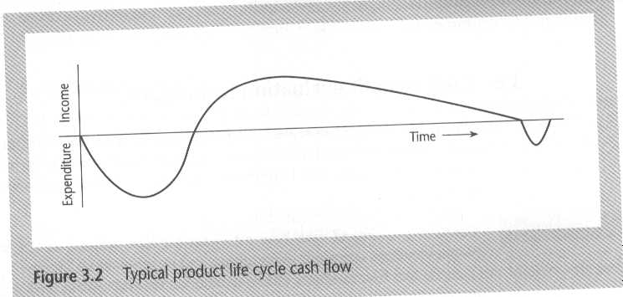
Cash flow forecasting
Indicates when expenditure and income will take place
Funding is required for negative cash flows – until break even (a point where neither profit nor loss)
Needs to be done early
Future cash flows are more uncertain
Inflation may be ignored
May be done on an annual, quarterly, or monthly basis

Slide 13
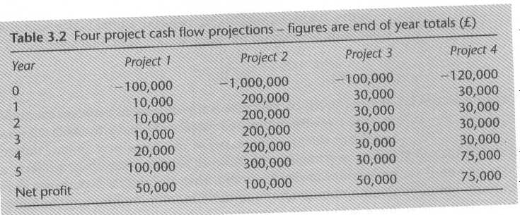
Project Cash flow example
Give Reasons about project which is the best among all?

Slide 14
Net profit
Difference between the total costs and total income
Does not consider investment or risk
Does not consider timing of cash flows

Slide 15
Payback period
Time taken to break even or pay back the initial investment
Generally, the project with the shortest payback period will be chosen on the basis that an organization will wish to minimize the time that a project is in debt.
Ignores overall profitability
Ignores income after break even
Ex: Consider the four project cash flow given in previous slide, calculate the payback period for each of them.

Slide 16
Return on investment (roi)
Comparing the net profitability to the investment required
ROI = average annual profit/total investment * 100
Takes no account of cash flows
A project with highest ROI is more beneficial
Ex: Calculate The ROI for project 1, the net profit is $50,000 and the total investment is $100,000. 10,000 50,000 in 5 year (each year 10,000) ROI = --------- X 100 = 10% 100,000

Slide 17
Net present value (npv)
Takes into account profitability and cash flows
Discounts future cash flows by a discount rate
Receiving $100 today is better than having to wait until next year to receive it, because we can invest the $100 and having $100 plus in the year’s time.
NPV is obtained by discounting each cash flow and summing the result
Same discount rate should be used in comparisons
Can be thought of as a target rate of return
Cannot be used for comparison with interest rates

Slide 18
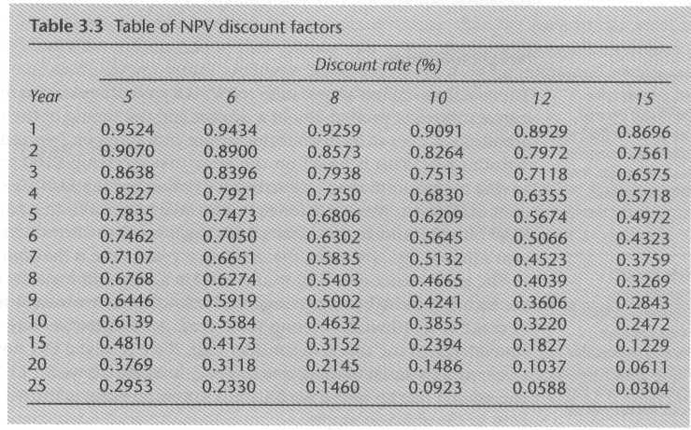
Npv discount factor table

Slide 19
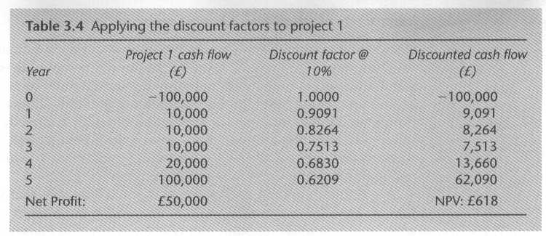
applying discount factors

Slide 20
Internal rate of return (IRR)
Profitability measure as a percentage rate that is directly comparable with interest rates (other investments or cost of borrowing)
Percentage discount rate that produces a NPV of 0
Does not indicate absolute size of return
Possible to find more than one number

Slide 21
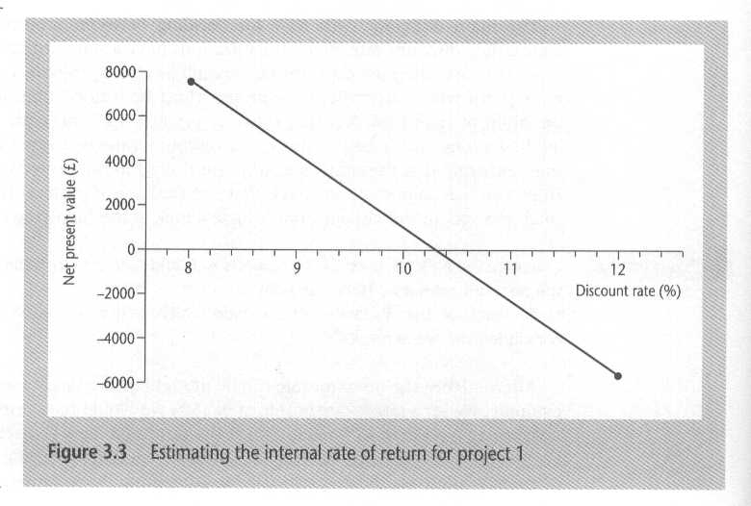
Estimating irr

Slide 22
Internal rate of return (IRR)
IRR = R1 + ((NPV1 x (R2 - R1)) / (NPV1 - NPV2))
here R1 and R2 are the randomly selected discount rates, and NPV1 and NPV2 are the higher and lower net present values, respectively.
R1=10%, NPV1 = ?? (higher NPV value at lower Discount Rate)
R2=12% NPV2 = ?? (lower NPV value at higher Discount Rate)
IRR = ??

Slide 23
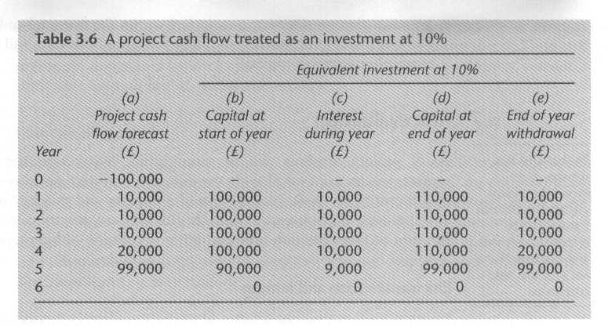
Project cash flow forecasting as investment
100,000
90,000

Slide 24
references
MMH
Bob Hughes and Mike Cotterel (1999). Software Project Management (Second Edition).
PMBOK Guide: Project Lifecycle (5th Edition)

